Slide 1
Customer Reviews As a Marketing Channel
What Business Owners Can Do to Get More Reviews and Why They Should

Slide 2
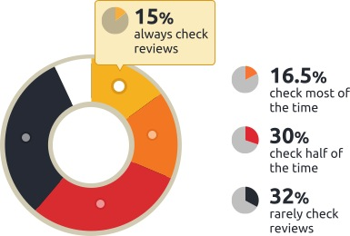
Almost Everyone Reads Reviews
Before dining or shopping, 93% of U.S. consumers check online reviews at least some of the time.
Source: “Poll: 93% of Respondents Check Reviews Before Dining or Shopping.” Street Fight, 2012; Available from: http://streetfightmag.com/2012/09/05/poll-93-of-respondents-check-reviews-before-dining-or-shopping/.

Slide 3
Reviews Are Trusted
72% of consumers trust online reviews as much as recommendations from friends and family
Source: Anderson, M. “Local Consumer Review Survey.” 2012; Available from: http://searchengineland.com/study-72-of-consumers-trust-online-reviews-as-much-as-personal-recommendations-114152.

Slide 4
Reviews Are Influential
4 out of 5 consumers have reversed a purchase decision based on negative online reviews.
Source: “Online Influence Trend Tracker.” Cone Communications, 2011; Available from: http://www.conecomm.com/2011coneonlineinfluencetrendtracker.

Slide 5
Good Reviews Are Under-Represented
Unhappy customers tell an average of 24 people about their experience; happy ones tell 15 people.
Source: American Express® Global Customer Service Barometer. 2012; Available from: http://about.americanexpress.com/news/pr/2012/gcsb.aspx.

Slide 6
Good Reviews Are Waiting to Happen
90% of typical U.S. consumers read online reviews; 6% write them
Source: “Local business reviews are the digital version of word-of-mouth advertising.” Local Viewpoints, 2013; Available from: https://local.viewpoints.com/customer-feedback-stats.

Slide 7
Top Reasons Your Happy Customers Don’t Already Write Reviews
“Writing reviews is too tedious”
“I forgot to write the review”
“I have no time”

Slide 8
How to Convert More Happy Customers Into Reviewers
Remind them to write a review
Make the process easier
Avail them of it during their downtime

Slide 9
Solution: A “Review Funnel”

Slide 10
How a Review Funnel Works
Ask and remind customers to share their experience online
Drive customers to a destination designed to convert them into reviewers
Guide each reviewer through selecting the best review site and completing a review

Slide 11
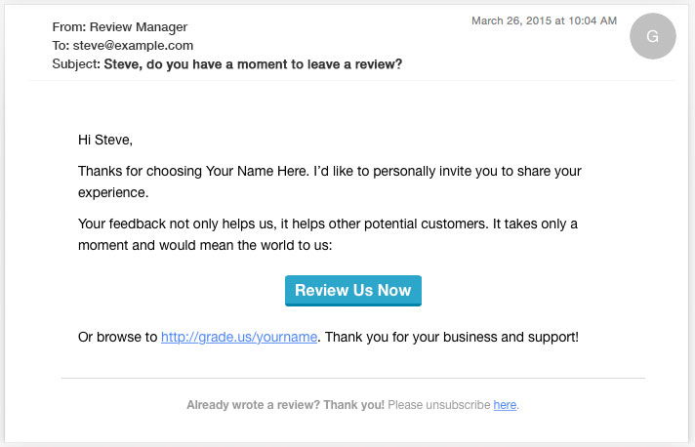
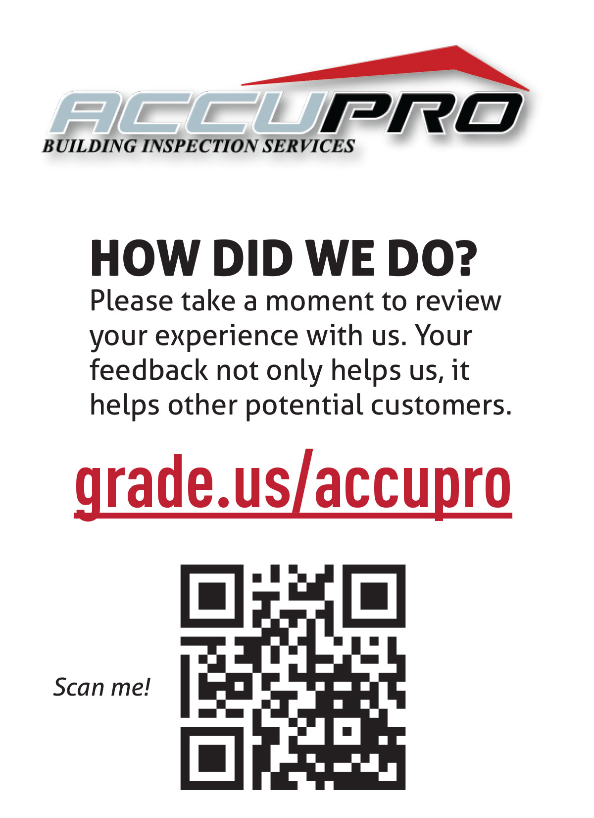
Use multiple channels to drive customers into the funnel
Email drip campaigns
SMS messages
Printed “invites” and takeaways
Signage
Other?

Slide 12
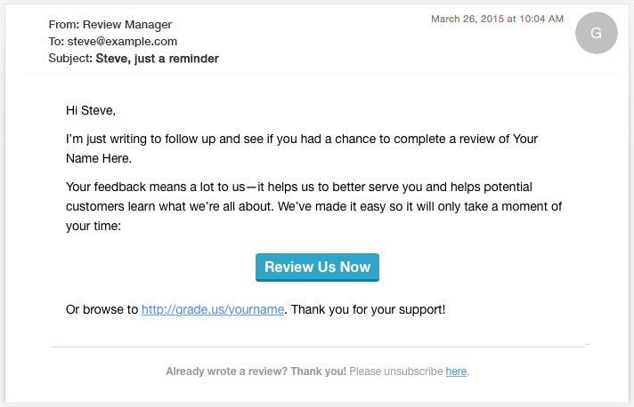
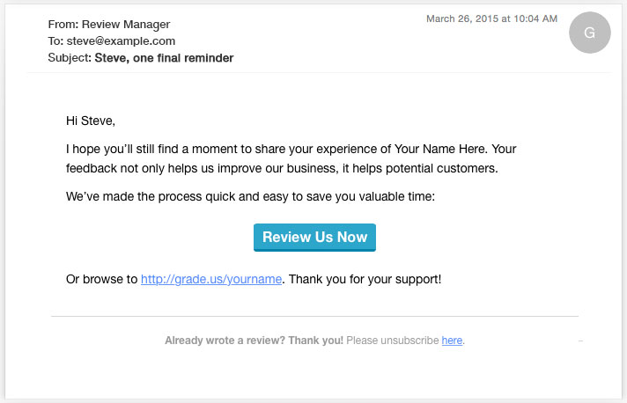
Example email drip campaign
Increasing urgency

Slide 13
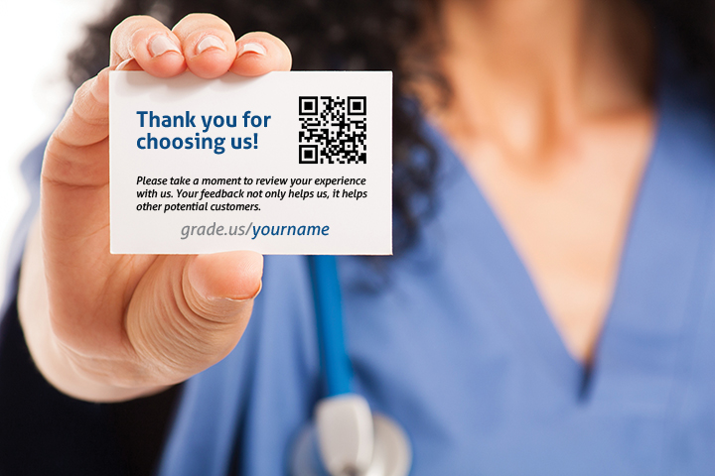

Slide 14
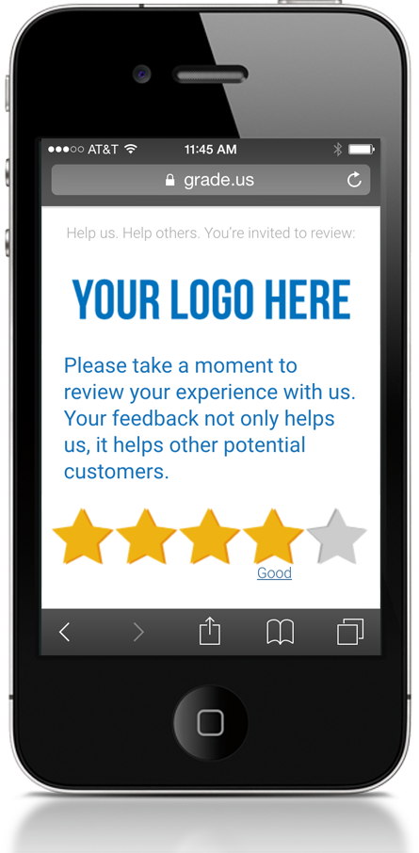
Convert customers into reviewers
Provide a clear, distraction-free landing page
Identify unhappy customers for a service recovery
Highlight conversion triggers such as Facebook login
Set the customers’ expectations and guide them

Slide 15
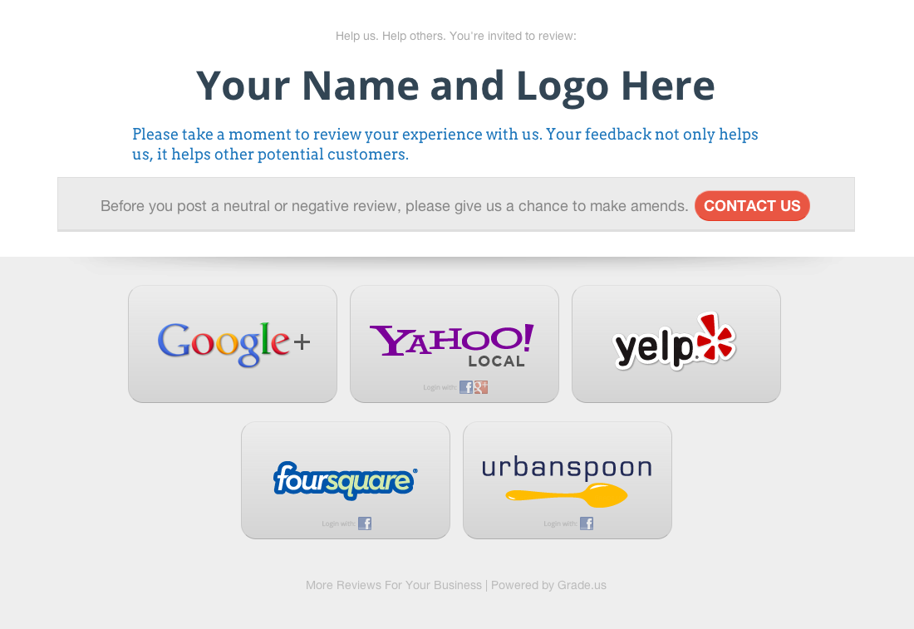

Slide 16
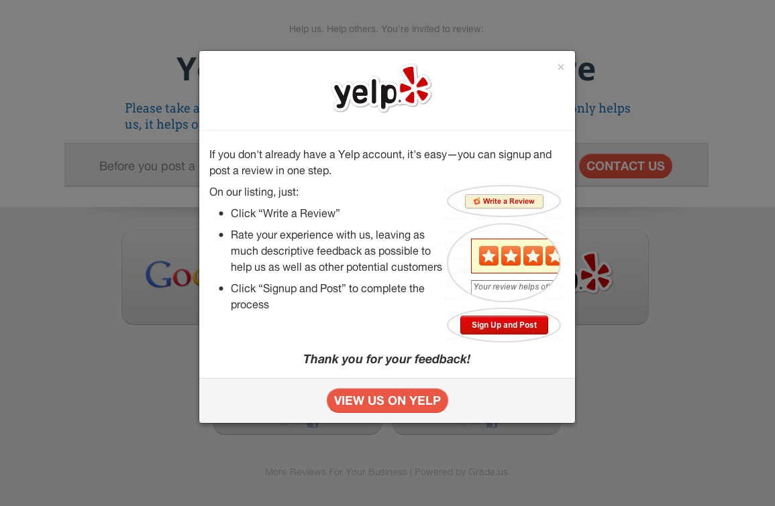

Slide 17
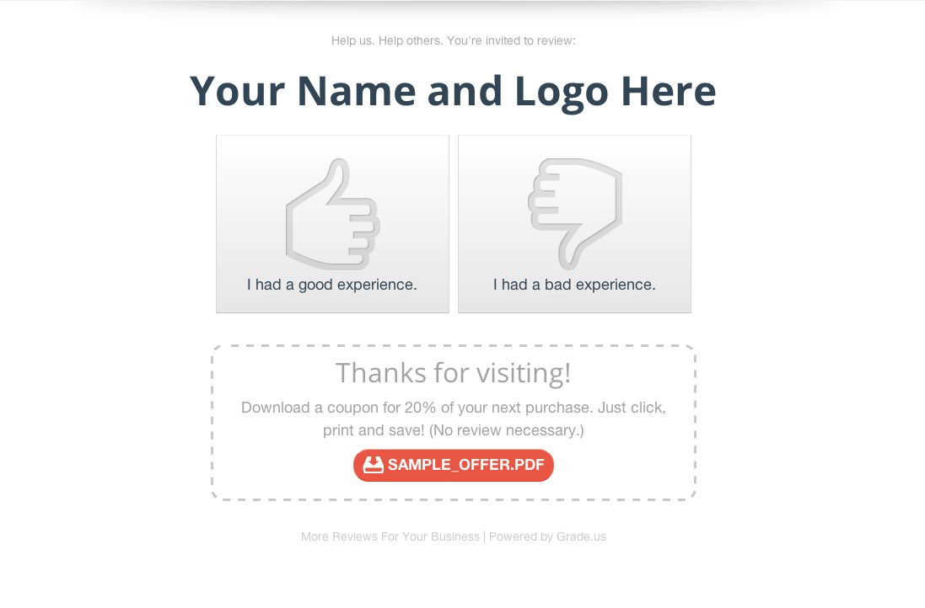

Slide 18
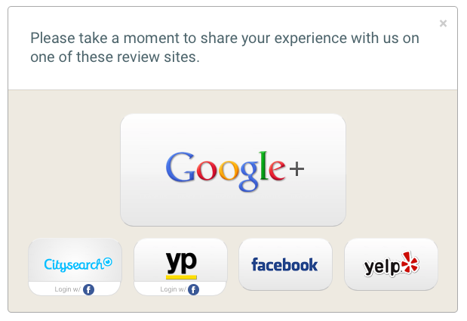
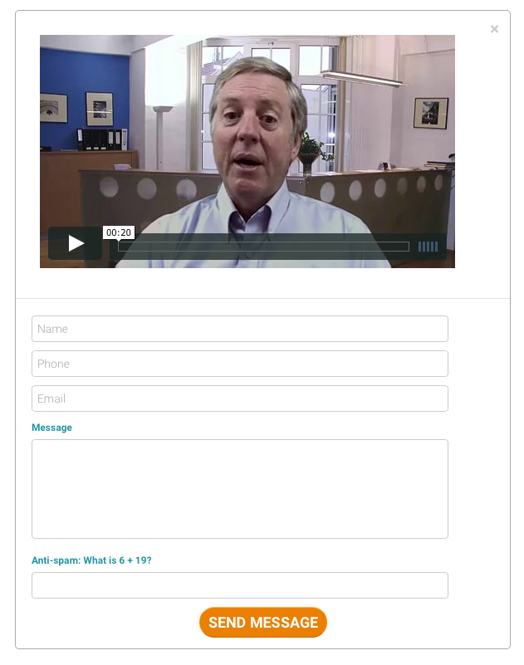
Identify unhappy customers before they write a review
Happy customer? Great….
Unhappy customer? Let’s talk….

Slide 19
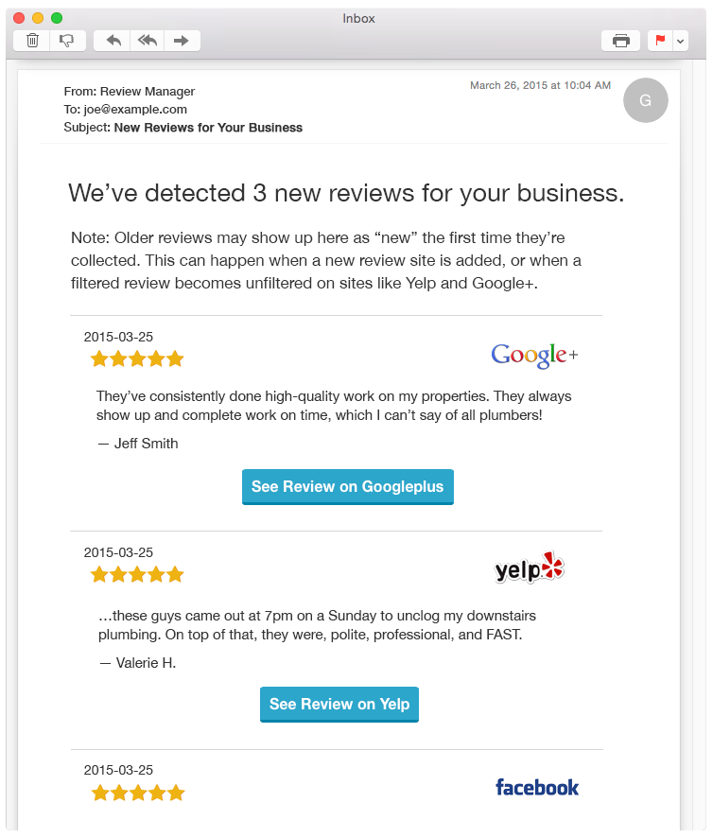
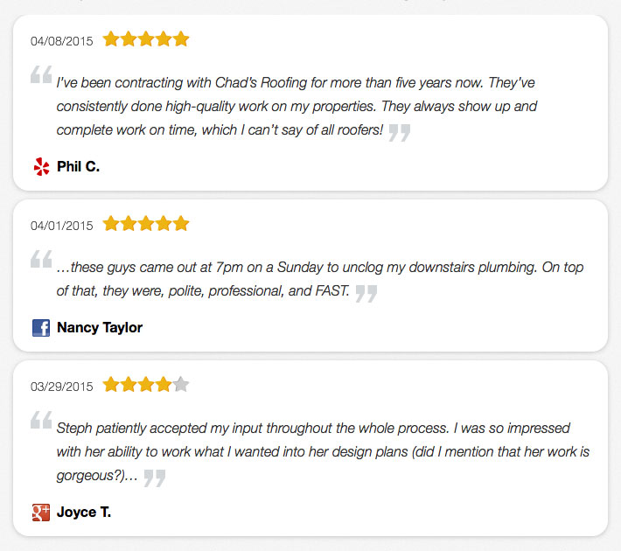
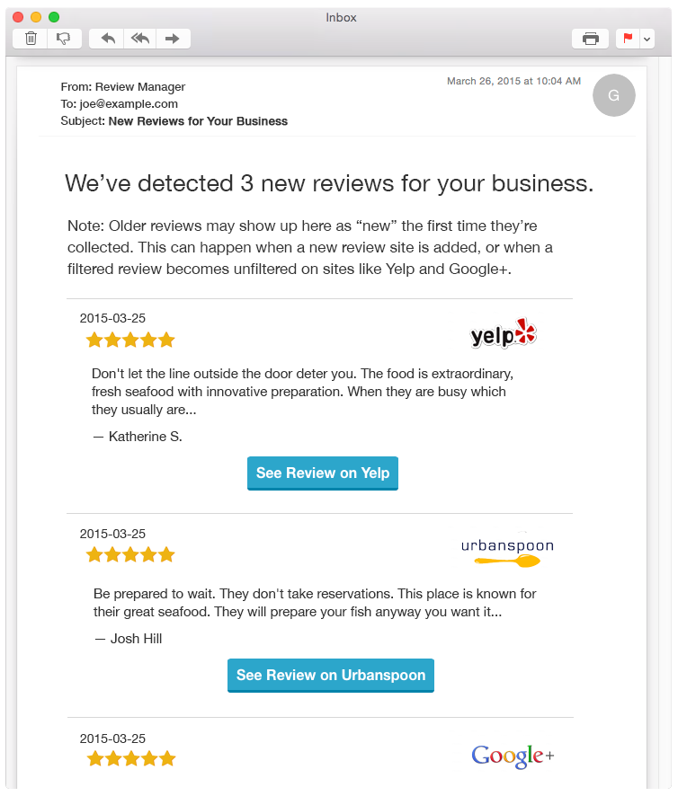
Monitor and respond to reviews; amplify your latest and greatest!
Review “stream” on website
Review alerts by email

